Slide 1
Predicting Sperm Quality with Artificial Intelligence
Brandon H. Tomlin

Slide 2
Index
Purpose
Experiment replication
Efficient Run Time for Big Data Structures
Data
Architectural layout
Future Improvements
Models
The Study
Mine
Conclusion

Slide 3
Purpose
Multilayered purpose:
The purpose of this project was not to find a novel way to predict whether or not a potential sperm donor would qualify as a donor, but to see if the results of a given study could be reproduced [1].
The second purpose of this project was to experiment with different ways to build classification models, and to run these models in a way that would be advantageous to a cloud computing platform.

Slide 4
Data
The dataset that was used in the experiment was a relative simplistic dataset. It was composed of 10 unique features, and 100 unique rows from 100 different possible male sperm donors.
Features: target, Season, Age, Childhood_Disease, Accidents, Surgical_Intervention, Fever, Drinking, Smoking, Hours_Sitting_Per_Day
More information about the collection methodology and data transformation can be found at [2].

Slide 5
Architectural layout
Read Libraries
Read in Data
Data Prep
Def prepareTarget()
Encodes target variable, transforms data, standardizes target to column 0 of data set, then does a quick high level data cleansing.
Test Train / Metric Functions
Test / Train Function
Metric Functions
Def ConfusionMatrixplot()
Def CvScoring()
Def accScoring()
Def Grid Search()
** This will later be turned into a Class object with more metrics that support the various models that will be ran.

Slide 6
Architectural layout: Body
workerFunction()
The workerFunction runs all fitting and predicting for strongLearners and weakLearners
fitting, train_prediction, test_prediction,
Accuracy_Scoring
List parameters:
names: Contains name of model being ran.
classifiers: Houses all models that will be produced for this experiment.
Def strongLearners():
Takes all models that I classified as “strongLearners” and runs our names, and classifiers through functions:
def ( workerFunction, accScore, confusionMatrix, CsScore)
Def weakLearners():
weakLearners operates on the exact same premise as strongLearners

Slide 7
Architectural layout: Execution
def runModels:
runs all Strong and Weak learners
def main():
def main():
dataPrep_Train()
runModels()
#strongLearners(names, classifiers) # for testing purposes
#weakLearners(weakNames, classifiers) # for testing purposes

Slide 8
Architectural layout: Future Improvements
For the upcoming version of this application, I have mapped out the following features that will be built into the next version.
(Some of these snips of code can already be found in the source, others are blocked out with pseudo code. )
Monitoring performance:
def current_timestamp():
def log_info(message):
def init_logging(log_file_path):

Slide 9
Architectural layout: Future Improvements
def candidate_families():
"""This will house all models AND PARAMETERS that
Will be ran throughout this problem space
Example:
svm_param = [{'C': [1, 10, 100, 1000], 'gamma': [0.001, 0.0001], 'kernel': ['rbf']},] candidates.append(['SVM', SVC(), svm_param ]) # Repeat process for all models candidates = pd.DataFrame(runModels) return candidates

Slide 10
Architectural layout: Future Improvements
def bestModel():
def decideMetrics(clf): ""“ Run logic that pulls metrics that are most applicable to the model that is currently being ran. # Pseudo Code ""“ ---------- Measuring of metrics --------- BUILT-IN ERROR HANDELING If clf is equal to model: Then run function associated with that model ifelse second ifelse third … else
run workerFunction
def saveCSV():

Slide 11
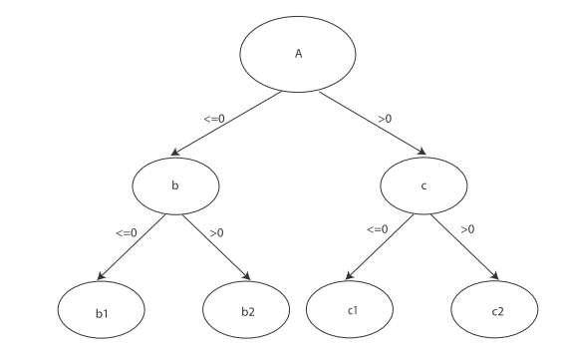
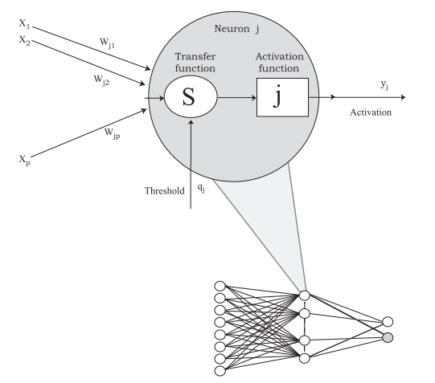
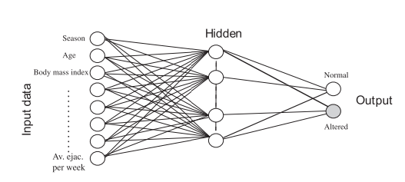
Models used in the study
Decision Trees
.
ANN ~ Multilayer Perceptron
.

Slide 12
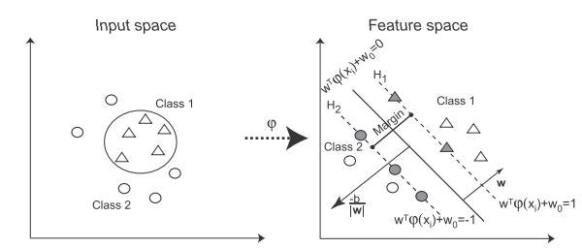
Models used in the study
Support Vector Machines: Radical Base Functions Kernel (RBF)
The choice for using a RBF kennel versus a linear kernel is because RBF kernels are able to map nonlinearly samples into higher dimensional space. Unlike linear, it can better handle when the class labels and attributes are nonlinear.

Slide 13
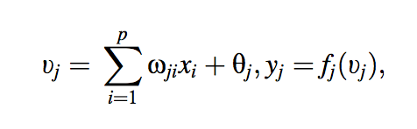
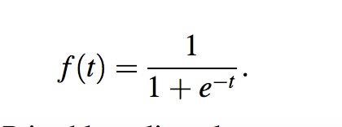
Experiment’s Model Methodology
The ANN is composed of three layers (where each one is fully connected to the next one): an input layer that receives external inputs, one hidden layer and output later, which normally, and is also true in our case, generates the classification results
After the first level of neurons (in the input layer), the rest of the neurons form computational elements with the nonlinear activation functions
Where vj is the linear combination of input x1,x2, …, xn and the threshold 0j; wji is the connection of weight between the inputs xi and the neuron j; fj, is the activation function of jth and yi is the output.
The sigmoid function is a common activation function that will be used in the study, and it is defined as:

Slide 14
Experiment’s Model Methodology: MLP architecture
Layer 1:
Layer is built automatically from the input vector, which in our case consist of the results from the survey that generated our features in slide 4.
Layer 2:
To decide the number of hidden neurons for this layer is the most difficult issue in the network’s architecture. This number represents the equilibrium between good accuracy and the possibility of over fitting.
Layer 3:
This layer is the output (classification) layer. The output corresponds to the different problem classes.
In our example there are two outputs: normal and altered.

Slide 15
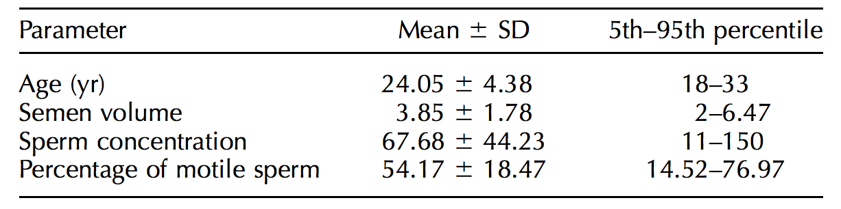
Experiment’s Results
The table below shows the mean of the seminal parameters from the study population. All of men surveyed, 38% had some alteration in sperm parameters [3].

Slide 16
ANN Performance
In order to keep a good generalization, and consequently a high accuracy, without getting overfitting, the experiments carried out show that a low number of neurons for layer 2 ( the hidden layer) led to a poor performance for both the training and test sets.
However, a high number of neurons performed very well for the training and test sets, although the risk of overfitting is high.
The studied used a 10-fold cross-validation method for the performance assessments of every network.

Slide 17
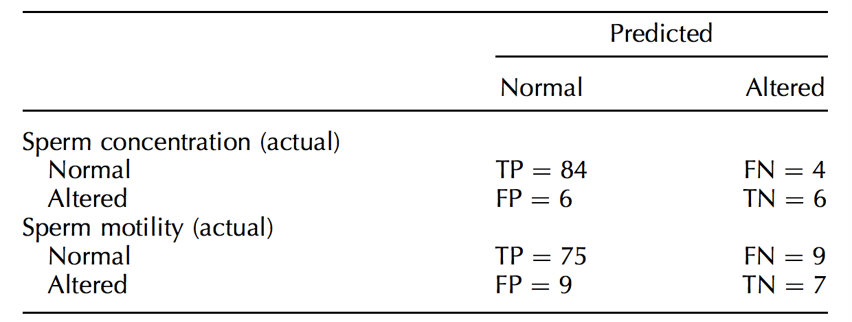
ANN Results

Slide 18
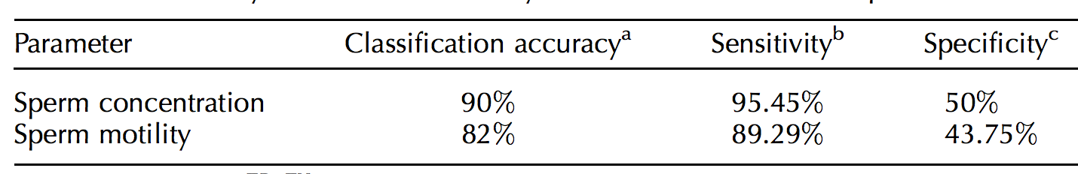
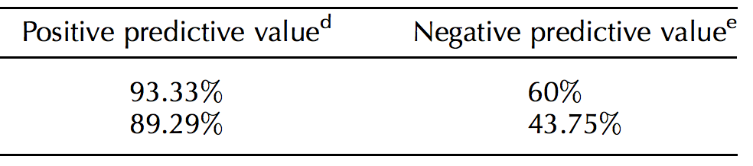
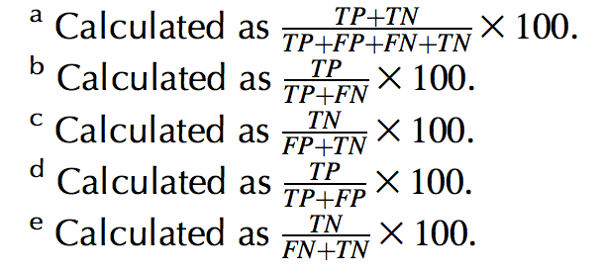
ANN Results

Slide 19
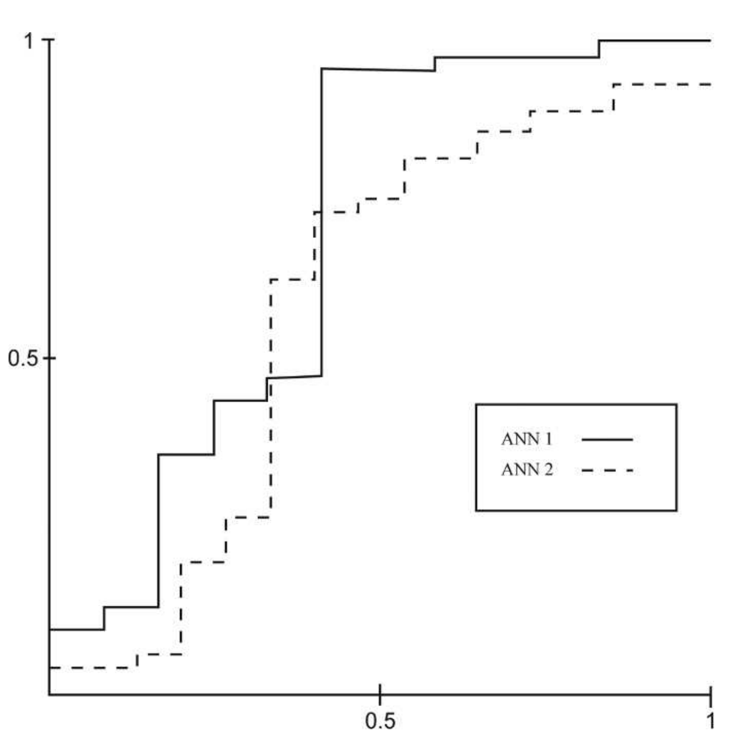
Experiment Conclusion / Remarks
The experiment carried out achieved a very good accuracy parameter for MLP. Among them, classification, accuracy, sensitivity, and negative predictive value obtain the highest precision values, whereas specificity and positive predictive value present lower percentages
Why does this happen?
This occurs even when the classification and the confusion matrix are good. An explanation for this can be found in the input data, because the study population shows an imbalanced distribution.
i.e. there are more individuals with normal semen parameters than people with alterations
One way to counter act this, would be to conduct a SMOTE on the dataset to introduce more alterations into the data set.

Slide 20
Replication of Study Results.
Decision Tree
Test/Train Accuracies : .850 / 0.925
Classification Report: Precision / Recall / F1
0 / 0.93 / 1.00 / 0.96
1 / 0.00 / 0.00 / 0.00
SVM
Test/Train Accuracies : 0.97 / 0.825
Classification Report: Precision / Recall / F1
0 / 0.97 / 0.84 / 0.90
1 / 0.25 / 0.67 / 0.36
ANN ~ MLP
Test/Train Accuracies : 0.900 / 0.950
Classification Report: Precision / Recall / F1
0 / 0.95/ 1.00 / 0.97
1 / 1.00 / 0.33 / 0.50

Slide 21
Models Outside of Study Scope Part 1
KNN
Test/Train Accuracies : .850 / .925
Classification Report: Precision / Recall / F1
0 / .93/ 1.00 / 0.925
1 / .00 / 0.00 / 0.00
RandomForest
Test/Train Accuracies : .983 /.950
Classification Report: Precision / Recall / F1
0 / 0.95 / 1.00 / .97
1 / 1.00 / 3.33 / 0.50
ExtraTrees
Test/Train Accuracies: .983 / .925
Classification Report: Precision / Recall / F1
0 / .95 / 0.97 / 0.96
1 / 0.50 / 0.33 / 0.40

Slide 22
Models Outside of Study Scope Part 2
GradientBoosting
Test/Train Accuracies: .983 / .875
Classification Report: Precision / Recall / F1
0 / 0.94 / 0.92 / 0.93
1 / 0.25 / 0.33 / 0.29
Stochastic Gradient Descent
Test/Train Accuracies: .567 / .550
Classification Report: Precision / Recall / F1
0 / 1.00 / 0.51 / 0.68
1 / 0.14 / 1.00 / 0.25

Slide 23
Conclusion
My Model: ANN (MPL)
Model Parameters: Classifier(batch_size=1, callback=None, debug=False, dropout_rate=None, f_stable=0.001, hidden0=<sknn.nn.Layer `Rectifier`: units=100, name=u'hidden0', frozen=False>, hidden1=<sknn.nn.Layer `Sigmoid`: units=100, name=u'hidden1', frozen=False, weight_decay=0.001>, layers=[<sknn.nn.Layer `Rectifier`: units=100, name=u'hidden0', frozen=False>, <sknn.nn.Layer `Sigmoid`: units=100, name=u'hidden1', frozen=False, weight_decay=0.001>, <sknn.nn.Layer `Softmax`: units=2L, name=u'output', frozen=False>], learning_momentum=0.05, learning_rate=0.02, learning_rule=u'sgd', loss_type=None, n_iter=100, n_stable=10, output=<sknn.nn.Layer `Softmax`: units=2L, name=u'output', frozen=False>, random_state=None, regularize=u'L2', valid_set=None, valid_size=0.0, verbose=None, warning=None, weight_decay=None, weights=None) classification report
Classification Report precision recall f1-score support 0 = no 0.95 1.00 0.97 37 1 = yes 1.00 0.33 0.50 3 avg / total 0.95 0.95 0.94 40
My Model:ExtraTrees
ExtraTreesClassifier(bootstrap=False, class_weight=None, criterion='gini', max_depth=None, max_features='auto', max_leaf_nodes=None, min_samples_leaf=1, min_samples_split=2, min_weight_fraction_leaf=0.0, n_estimators=10, n_jobs=1, oob_score=False, random_state=None, verbose=0, warm_start=False)
Test/Train Accuracies: .983 / .925
Classification Report: C / Precision / Recall / F1 0 / 0 .95 / 0.97 / 0.96 1 / 0.50 / 0.33 / 0.40

Slide 24
Reference
[1]
https://www.researchgate.net/publication/230868076_Predicting_seminal_quality_with_artificial_intelligence_methods
[2]
https://archive.ics.uci.edu/ml/datasets/Fertility

